Slide 1
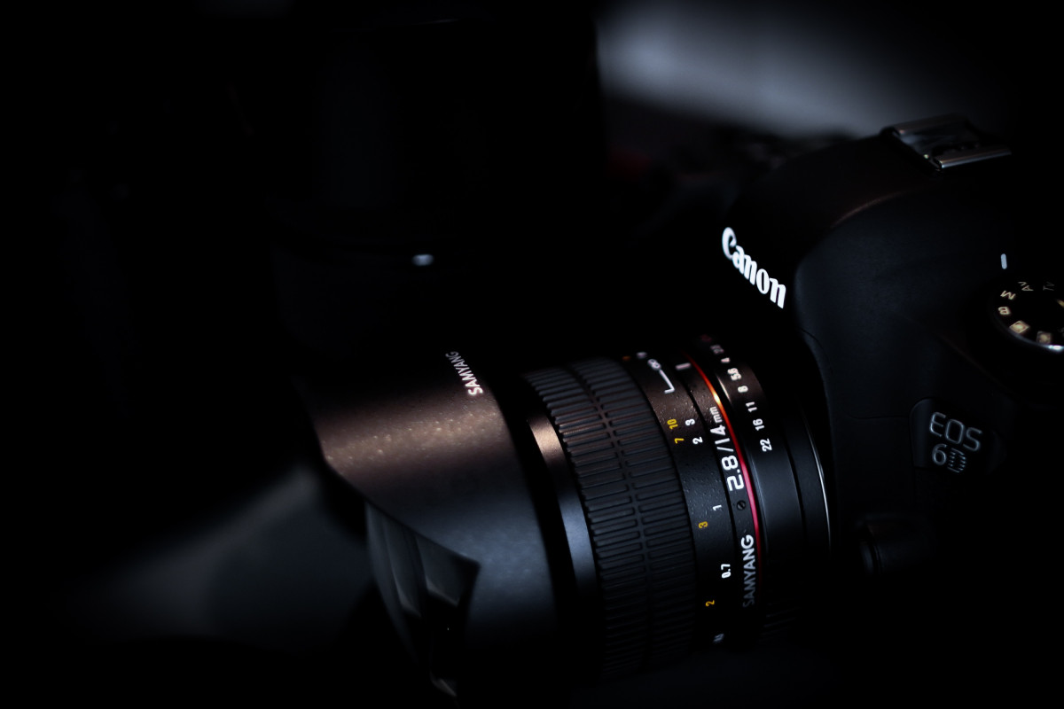
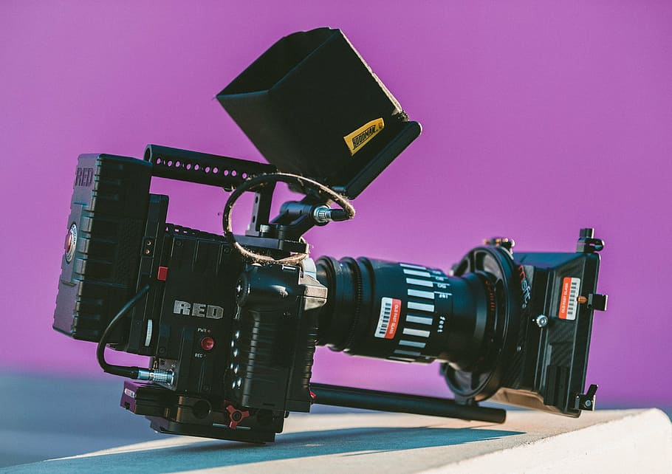
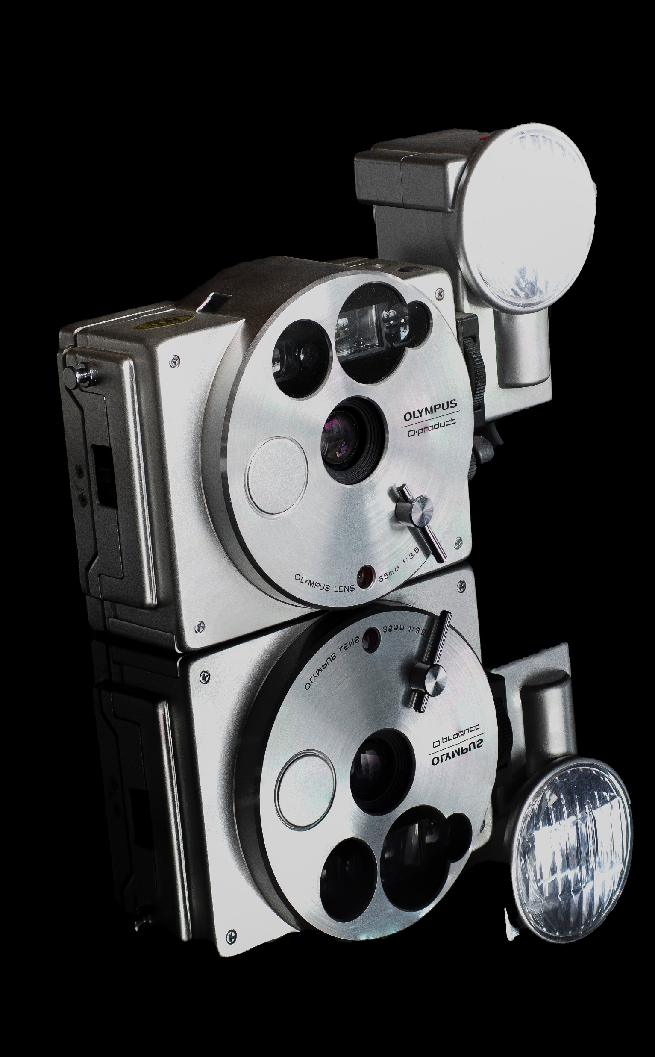
APP PHYSICS 167
APPLIED OPTICS
CAMERA CALIBRATION
IMAGING OPTICS AND ELECTRONICS
NINO PHILIP RAMONES | GITHUB
2020 – 05616
SEPTEMBER 21, 2023

Slide 2
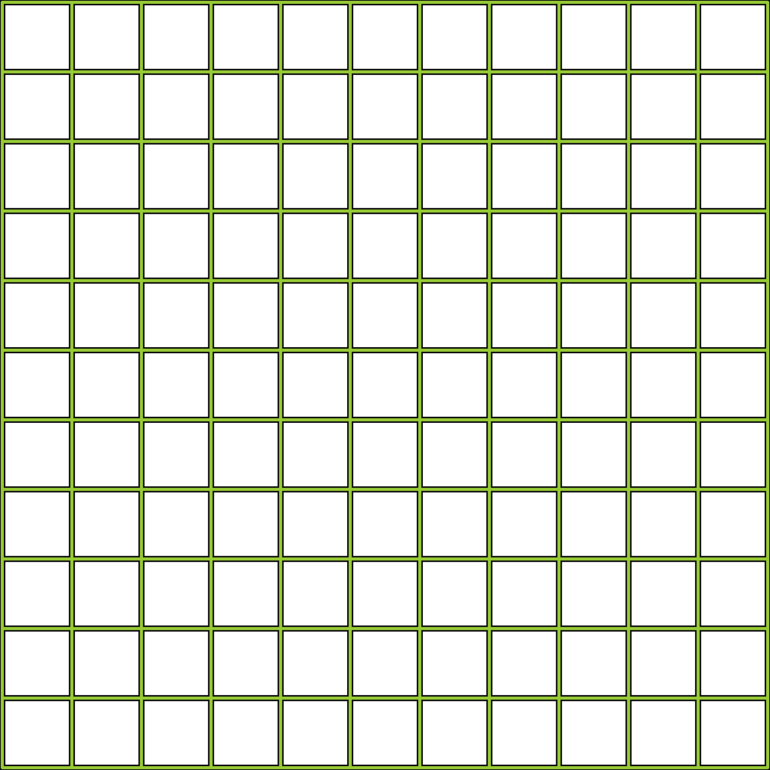
APP PHYSICS 167
CAMERA CALIBRATION
OBJECTIVES
Model the physical processes involved in the geometric aspects of image formation
Understand the general transformations that takes place in camera calibration techniques
Verify the calibration by picking real world coordinates and predicting their corresponding image coordinates
KEY TAKEAWAYS
We can transform a three-dimensional world coordinates to two-dimensional image coordinates
Camera calibration in principle is the reconstruction of these 3D coordinates
The camera parameters is used in the reconstruction of such 3D coordinates by relating the real-world and image coordinates
SOME PITFALLS
The choice of test points for calibration can affect the accuracy of the image coordinate prediction due to the possibility of extrapolating the data points --- position with respect to the origin must be taken into account

Slide 3
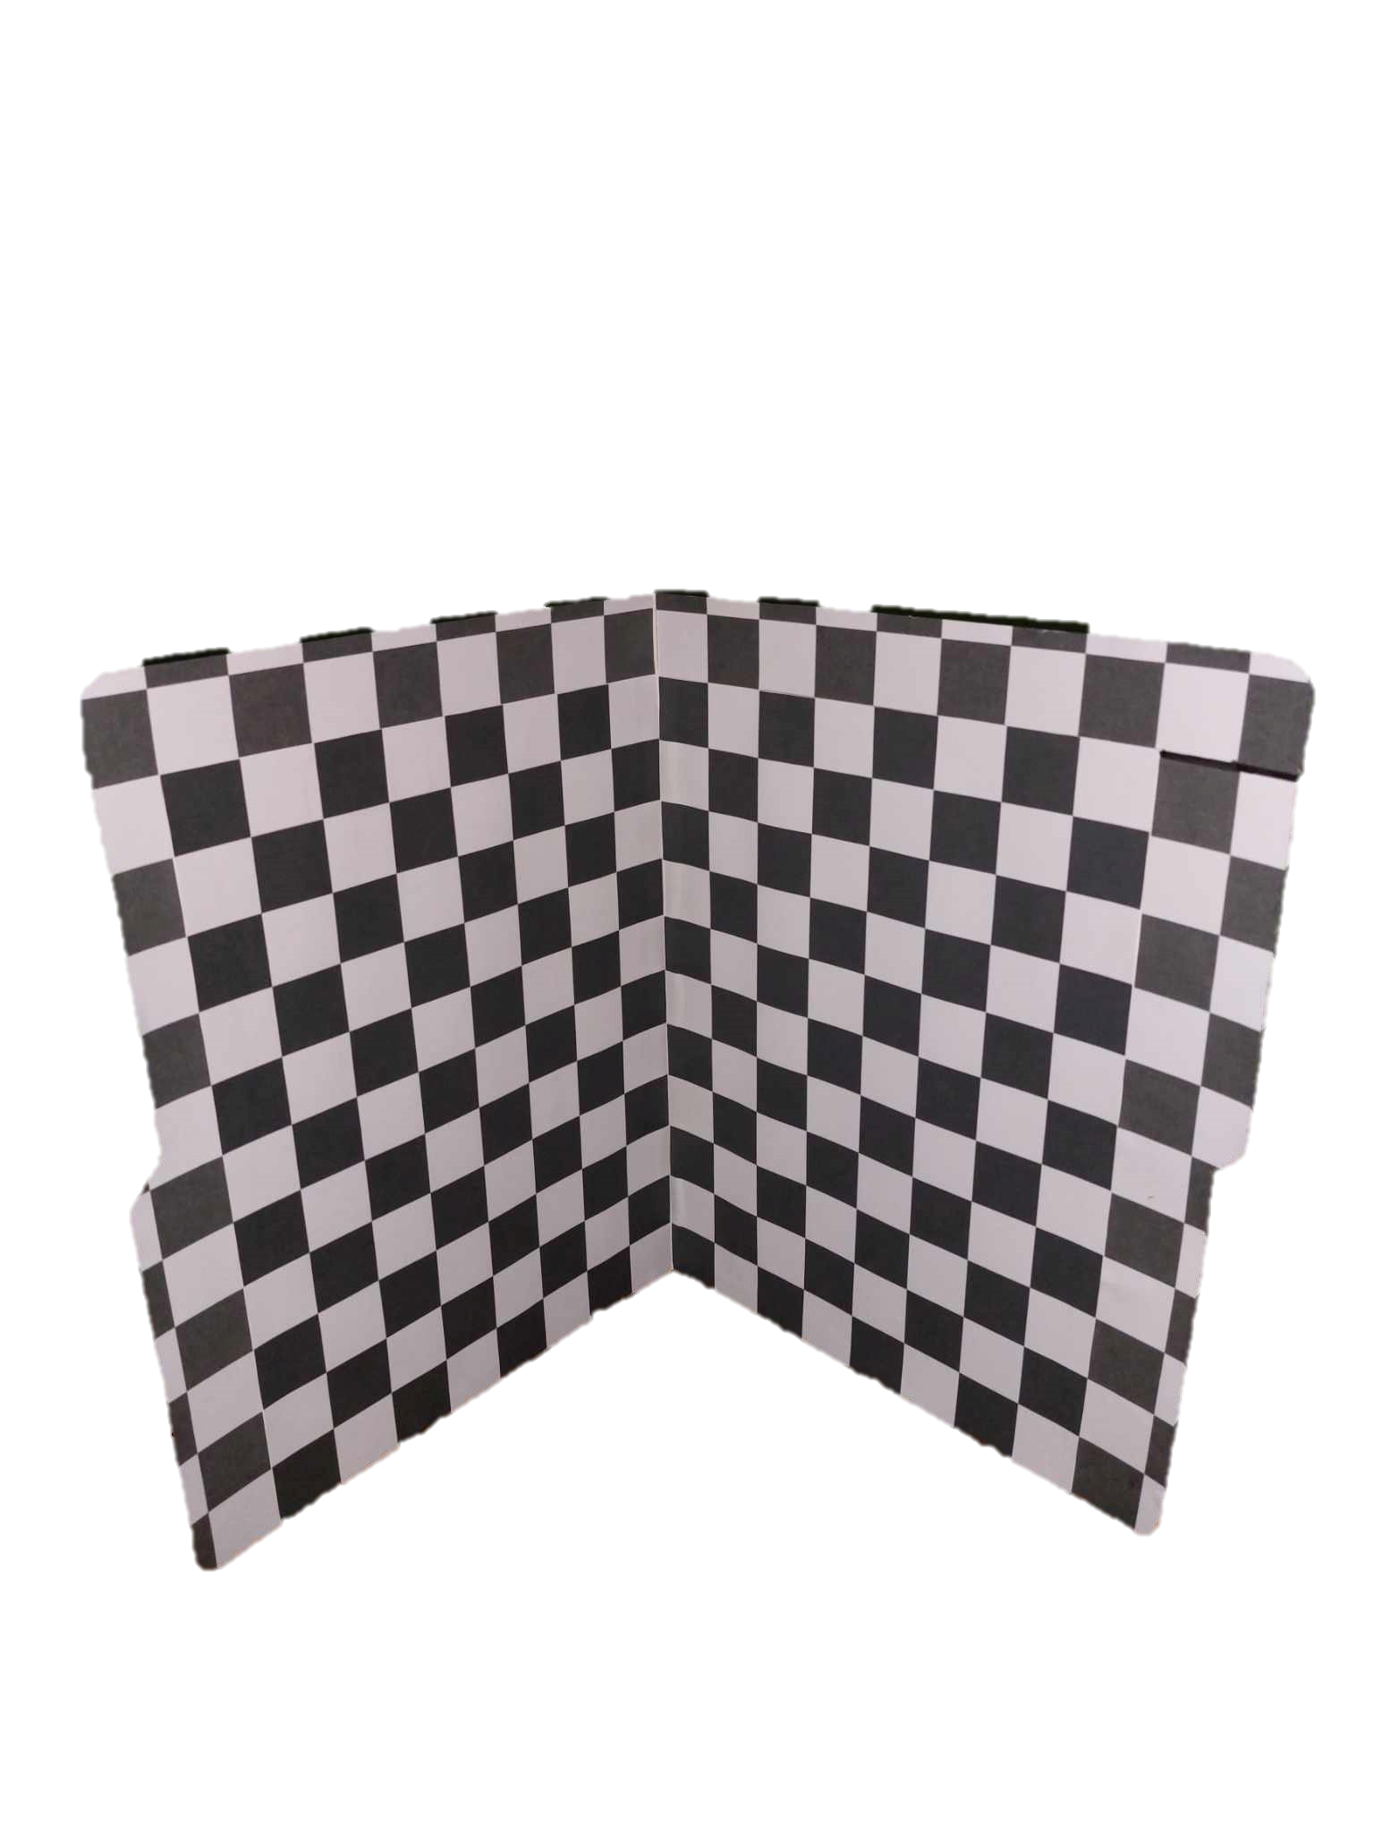




APP PHYSICS 167
CAMERA CALIBRATION
EXPERIMENTAL SETUP
A checkered grid of uniform square size was made using a folder, and the panels were positioned at a right angle.
20 points that are represented by yellow dots were randomly chosen on the grid to represent the real-world coordinates and using the transformation matrices and relations, the corresponding image coordinates were predicted.
The dots were positioned in the global coordinate basis with the origin at the bottom-most intersection of the panels. Hence, the need to make sure that they are at 90 degrees angle!
Figure 1. The Tsai grid used in the activity. The grid was used as the calibration board characterized by its uniform black and white squares of size 0.75 inches.

Slide 4

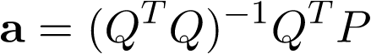
APP PHYSICS 167
CAMERA CALIBRATION
METHODOLOGY
1
Preparation of data. Take a picture of the Tsai grid that will be used for calibrating the camera. In this activity, a phone camera from Samsung model was used. The panels were positioned at a right angle as it will serve as the basis for the global coordinates.
2
Analysis of data. Microsoft Paint software was used to track and record the corresponding pixel or image coordinates of the chosen points shown in the previous slide. 20 points were tabulated with the respective global coordinates and their image coordinates.
3
Code algorithm. The camera parameters were computed from the chosen real-world points and their corresponding image points. The process was automated using Python for efficiency. We consider the equation where Q is a 2n by 11 matrix, a is the camera parameter, and p is the image point matrix of size 2n by 1 where n is the number of points taken from the grid. The camera parameter was quantified using the matrix relation

Slide 5
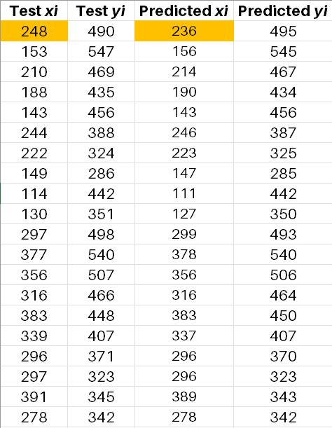
APP PHYSICS 167
CAMERA CALIBRATION
RESULTS AND DISCUSSION
The algorithm was able to predict the pixel coordinates of the chosen points up to the nearest tenth pixels. Minimal discrepancies between the test and predicted coordinates were obtained. However, a maximum of 12 pixels difference accounting for a 5.08% error were observed for the point nearest to the origin (highlighted in orange).
The chosen points for calibration were a mix of points that are near the origin and near the edges or corners of the grid. Even though the said point was positioned within the arbitrary region where the points were taken, the deviation could be attributed to the positions of the test points being inconsistent and random at a sense.
There were also some instances where the test and predicted coordinates match, which validates the argument that the prediction is quite accurate, and the calibration was done correctly.
Table 1. Comparison of the actual and predicted pixel coordinates of the chosen points on the grid.

Slide 6
APP PHYSICS 167
CAMERA CALIBRATION
RECOMMENDATIONS
Points for improvement and considerations
Minimize pixel differences. The dataset obtained produced on average a difference of around 3 to 5 pixels between the test and predicted coordinates. These can be circumvented by choosing test points on the grid at a reasonable manner that accounts for its position with respect to corners and origin. One possible way to minimize the discrepancies in values is to choose points along the edges of the Tsai grid. In this way, we can ensure that the point coordinates being predicted are not extrapolated from the region where the calibration was sampled. Hence, we can ensure that the error is minimized at most. See Figure 2 for the possible choice of test points marked in orange!
Number of test points matter. Just like in any standard experiments, increasing the number of test points could possibly affect the accuracy of the prediction. We can also consider increasing the number of trials in reading the pixel coordinates of the chosen point. This can be optional since the algorithm was able to predict the pixel coordinates at all.
Figure 2. Possible choice of test points that could minimize the error between the test and predicted image coordinates.

Slide 7
APP PHYSICS 167
CAMERA CALIBRATION
REFLECTION
I find the activity fun since it is straightforward and I was able to understand the rigors of doing the transformation and rotation matrices that comes into calibration, and apply it into real life of calibrating such camera. I was able to address some of the possible gaps and nuances in my results as the choices of my test points were random, which could lead to the possible extrapolation of data. I also thank Julian Maypa for sharing his code on implementing the algorithm since I got stuck in the middle of the code and I was able to recognize my mistakes on that part. Overall, I would give myself a score of 110/100 !
REFERENCES | GITHUB
M. Soriano, Applied Physics 167 – Geometric model for 3D imaging.
Tsai Camera Calibration (ed.ac.uk)

